Slide 1

Data Structure
(Data)
(structure)
Hashing Tree
Introduction
Key Concepts
Terminologies
Collision Resolution
Types

Slide 2
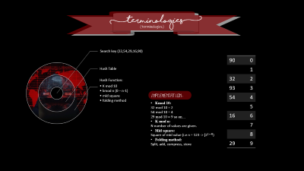
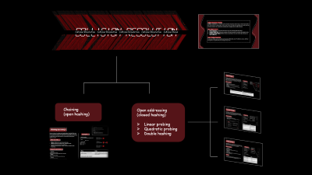
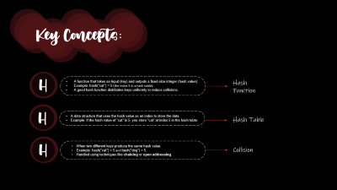
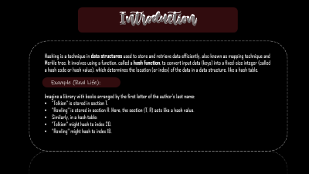



Data Structure
(Data)
(structure)
Hashing Tree
Introduction
Key Concepts
Terminologies
Collision Resolution
Types

Slide 3
Introduction
Introduction
Hashing is a technique in data structures used to store and retrieve data efficiently, also known as mapping technique and Merkle tree. It involves using a function, called a hash function, to convert input data (keys) into a fixed-size integer (called a hash code or hash value), which determines the location (or index) of the data in a data structure, like a hash table.
Example (Real Life):
Imagine a library with books arranged by the first letter of the author's last name:
"Tolkien" is stored in section T.
"Rowling" is stored in section R. Here, the section (T, R) acts like a hash value.
Similarly, in a hash table:
"Tolkien" might hash to index 20.
"Rowling" might hash to index 18.

Slide 4
Key Concepts:
H
A function that takes an input (key) and outputs a fixed-size integer (hash value).
Example: hash("cat") = 5 (the index 5 in a hash table).
A good hash function distributes keys uniformly to reduce collisions.
Hash Function
H
A data structure that uses the hash value as an index to store the data.
Example: If the hash value of "cat" is 5, you store "cat" at index 5 in the hash table.
Hash Table
H
When two different keys produce the same hash value.
Example: hash("cat") = 5 and hash("dog") = 5.
Handled using techniques like chaining or open addressing.
Collision

Slide 5
(terminologies)
(terminologies)
Search key (32,54,29,16,90)
Hash Table
Hash Function:
K mod 10
kmod n (0 – n-1)
mid square
folding method
90 | 0
 | 1
32 | 2
93 | 3
54 | 4
 | 5
16 | 6
 | 7
 | 8
29 | 9
Implementation:
Kmod 10:
32 mod 10 = 2
54 mod 10 = 4
29 mod 10 = 9 so on…
K mod n:
N number of values are given.
Mid square:
Square of mid value (i.e n = 123 -> [2^{2 = 4]})
Folding method:
Split, add, compress, store

Slide 6

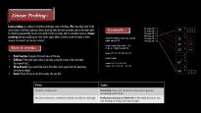
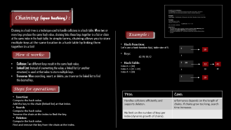

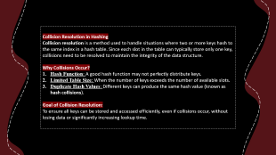

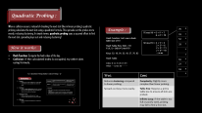



Collision Resolution
Collision Resolution Collision Resolution Collision Resolution Collision Resolution Collision Resol
Chaining
(open hashing)
Open addressing
(closed hashing)
Linear probing
Quadratic probing
Double hashing

Slide 7
Collision Resolution in Hashing
Collision resolution is a method used to handle situations where two or more keys hash to the same index in a hash table. Since each slot in the table can typically store only one key, collisions need to be resolved to maintain the integrity of the data structure.
Why Collisions Occur?
Hash Function: A good hash function may not perfectly distribute keys.
Limited Table Size: When the number of keys exceeds the number of available slots.
Duplicate Hash Values: Different keys can produce the same hash value (known as hash collisions).
Goal of Collision Resolution:
To ensure all keys can be stored and accessed efficiently, even if collisions occur, without losing data or significantly increasing lookup time.

Slide 8
Collision Resolution
Collision Resolution Collision Resolution Collision Resolution Collision Resolution Collision Resol
Chaining
(open hashing)
Open addressing
(closed hashing)
Linear probing
Quadratic probing
Double hashing

Slide 9
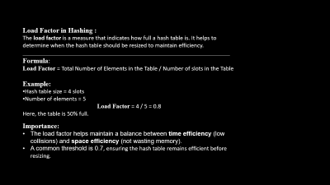

Chaining (open hashing) :
Chaining in a hash tree is a technique used to handle collisions in a hash table. When two or more keys produce the same hash value, chaining links these keys together in a list or chain at the same index in the hash table. In simple terms, chaining allows you to store multiple keys at the same location in a hash table by linking them together in a list!
Example :
Hash Function:
Let’s use a hash function h(x), table size of 5.
Keys:
42,19,10,12
Hash Table:
Index 0 -> [10]
Index 2 -> [12 -> 42]
Index 4 -> [19]
0
1
2 | 20
3
4
10
How it works:
Collision: Two different keys result in the same hash value.
Linked List: Instead of overwriting the value, a linked list (or another structure) is used at that index to store multiple keys.
Traverse: When searching, insert, or delete, you traverse the linked list to find the desired key.
12
42
20
10
19
Steps for operations:
Pros | Cons
Handles collisions efficiently and supports deleton. | erformance depends on the length of chains. If chains grow too long, search time increases.
No limit on the number of keys per index (dynamic growth of chains).
Insertion:
Compute the hash value.
Add the key to the chain (linked list) at that index.
Search:
Compute the hash value.
Traverse the chain at the index to find the key.
Deletion:
Compute the hash value.
Find and remove the key from the chain at the index.

Slide 10
Load Factor in Hashing :
The load factor is a measure that indicates how full a hash table is. It helps to determine when the hash table should be resized to maintain efficiency.
___________________________________________________________________
Formula:
Load Factor = Total Number of Elements in the Table / Number of slots in the Table​
Example:
Hash table size = 4 slots
Number of elements = 5
Load Factor = 4 / 5 = 0.8
Here, the table is 50% full.
Importance:
The load factor helps maintain a balance between time efficiency (low collisions) and space efficiency (not wasting memory).
A common threshold is 0.7, ensuring the hash table remains efficient before resizing.

Slide 11
Linear Probing :
Linear probing is a collision resolution technique used in hashing. When two keys hash to the same index (a collision happens), linear probing finds the next available spot in the hash table by checking sequentially (one by one) until it finds an empty slot. In simple terms, linear probing keeps looking at the next spot (like a line) until it finds a free space to insert or locate a key!
Example :
67 mod 10 = 7
12 mod 10 = 2
22 mod 10 = 2
99 mod 10 = 9
32 mod 10 = 2
19 mod 10 = 9
19 | 0
 | 1
12 | 2
22 | 3
32 | 4
 | 5
 | 6
67 | 7
 | 8
99 | 9
9 + 1
Hash Function: Let’s use a hash table size of 10
Hash Table Size: h(k) = 10
h’ (k, i) = (h(k)+i) mod 10
Keys: 67, 12, 22, 99, 32, 19
Hash Table:
Index: 0 1 2 3 4 5 6 7 8 9
Value: 19 - 12 22 32 - - -67- 99
2
2 + 1
How it works:
2 + 2
Hash Function: Compute the hash value of the key.
Collision: If the hash value index is already occupied, move to the next index (increment by 1).
Wrap Around: If you reach the end of the table, start again from the beginning (circular probing).
Insert: Place the key in the first empty slot you find.
9
Pros | Cons
Simple to implement. | Clustering: Keys with close hash values form groups, increasing search time.
No extra memory is needed for linked lists (like in chaining). | Performance Drops as Table Fills: If the table becomes too full, finding an empty slot takes longer.

Slide 12
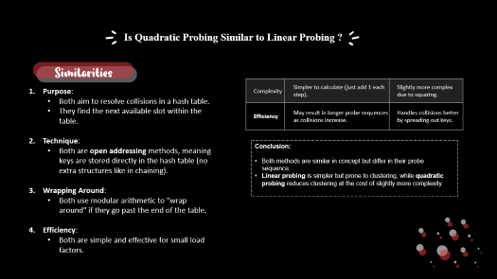

Quadratic Probing :
When a collision occurs, instead of checking the next slot (like in linear probing), quadratic probing calculates the next slot using a quadratic formula. This spreads out the probes more evenly, reducing clustering. In simple terms, quadratic probing uses a squared offset to find the next slot, spreading keys out and reducing clustering!
Example :
76 | 0
91 | 1
52 | 2
33 | 3
 | 4
 | 5
16 | 6
27 | 7
18 | 8
 | 9
76 mod 10 = 6 + 1² = 7
6 + 2² = 10
Hash Function: Let’s use a hash table size of 10
Hash Table Size: h(k) = 10
h’ (k, i) = (h(k)+i²) mod 10
Keys: 52, 16, 91, 33, 18, 27, 76, 92
Hash Table:
Index: 0 1 2 3 4 5 6 7 8 9
Value: - - 12 22 32 - - - - -
92 mod 10 = 2 + 1² = 3
2 + 2² = 6
2 + 3² = 11
2 + 4² = 18
… so on
How it works:
Hash Function: Compute the hash value of the key.
Collision: If the calculated index is occupied, try other slots using formula.
Pros | Cons
Reduces clustering compared to linear probing. | Complexity: Slightly more complex than linear probing.
Spreads out keys more evenly. | Table Size: Requires a prime table size to ensure all slots are probed.
 | Infinite Loop: If the table is too full or poorly sized, probing may fail to find a free slot.

Slide 13
Is Quadratic Probing Similar to Linear Probing ?
Similarities
Purpose:
Both aim to resolve collisions in a hash table.
They find the next available slot within the table.
Technique:
Both are open addressing methods, meaning keys are stored directly in the hash table (no extra structures like in chaining).
Wrapping Around:
Both use modular arithmetic to "wrap around" if they go past the end of the table.
Efficiency:
Both are simple and effective for small load factors.
Complexity | Simpler to calculate (just add 1 each step). | Slightly more complex due to squaring.
Efficiency | May result in longer probe sequences as collisions increase. | Handles collisions better by spreading out keys.
Conclusion:
Both methods are similar in concept but differ in their probe sequence.
Linear probing is simpler but prone to clustering, while quadratic probing reduces clustering at the cost of slightly more complexity.

Slide 14
Double Hashing :
Double hashing is a collision resolution technique in hashing. It uses a second hash function to determine the step size for probing when a collision occurs. This ensures that the probing sequence is more spread out, reducing clustering and improving efficiency.
Example :
 | 0
 | 1
 | 2
36 | 3
64 | 4
 | 5
42 | 6
 | 7
75 | 8
 | 9
 | 10
 | 11
36 mod 12 = 3
64 mod 12 = 4
42 mod 12 = 6
75 mod 12 = 3
Hash Function: Let’s use a hash table size of 12
Hash Table Size: h(k) = 10
h1(k) = k mod 12
H2(k) = 5 – k mod 5
Keys : 36, 64, 42, 75
Hash Table:
Index: 0 1 2 3 4 5 6 7 8 9
Value: - - - 36 64 - 42 - 75 - - -
How it works:
h1(k) + i h2(k)
3 + (1) 5 = 8
Hash Functions:
A primary hash function: h1(k) .
A secondary hash function: h2(k) [used to calculate the step size] .
Probing Formula:
h1(k) + i h2(k)
Collision Handling:
If a collision occurs at the computed index, use the second hash function to calculate the step size and try the next index.
Pros | Cons
Reduces both primary and secondary clustering. | Requires two good hash functions.
Ensures better distribution of keys across the table. | Slightly more complex to implement.
More efficient probing compared to linear and quadratic probing. | May still fail if the table is too full.
Note :
The secondary hash function ensures that the step size is not constant, unlike linear or quadratic probing. This avoids primary and secondary clustering.

Slide 15

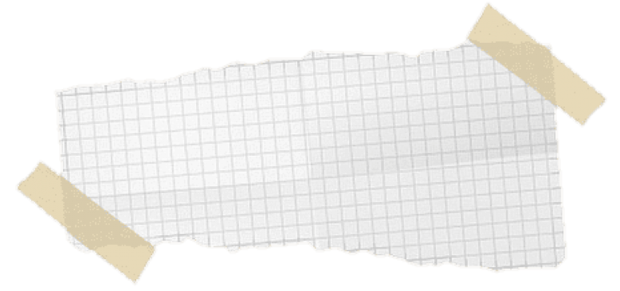
Thank you.ᐟ

